Slide 1
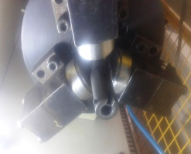
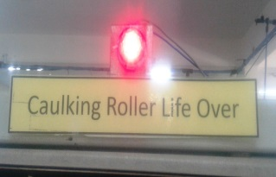
P14
TPM CIRCLE NO :- 2
ACTIVITY
KK
QM
PM
JH
SHE
OT
DM
E&T
KAIZEN IDEA SHEET
TPM CIRCLE NAME : Joshile
LOSS NO. / STEP
DEPT :- Manufacturing Engg.
RESULT AREA
P
Q
DEF :- A
C
D
S
M
CELL :-A491
CELL NAME:- Auto Fuel Cock
MACHINE / STAGE :- Sealing/ Caulking
OPERATION :- Operation No. 40
KAIZEN THEME : To Prevent the may happen Defect at caulking stage in A491 AFC Assy. cell
IDEA :- Auto provision to be provide in machine for caulking Roller life monitoring.
COUNTERMEASURE:- Provided Auto provision in machine for caulking roller life monitoring by interlocking PLC logic & No chance of caulking area damage & crack in body due caulking roller.
BENCHMARK
0
WIDELY/DEEPLY:-
TARGET
0
KAIZEN START
24.02.2016
PROBLEM / PRESENT STATUS :- No Auto Provision in machine for caulking roller life monitoring.& May happen defect of Caulking area damage & crack in body due to caulking roller.
KAIZEN FINISH
28.02.2016
Buzzer system of roller life over for operator awareness
TEAM MEMBERS :-
N.S.Pujari , Mr. Dinesh
BENEFITS :-
No Auto Provision for Roller life monitoring
1.Prevent In-house rejection.
KAIZEN SUSTENANCE
Caulking roller
Video clip
BEFORE
AFTER
WHAT TO DO: ---
HOW TO DO: ---
FREQUENCY : Irreversible kaizen.
WHY - WHY ANALYSIS :-
Why1: May happen defect of Caulking area damage & crack in body due to Roller
Why2 : No Auto Provision for caulking roller life monitoring.
Why 3:- No auto provision in machine for caulking roller life monitoring.
RESULT :-
By Luck No defect due to caulking roller
Prevent May happen defect by improvement.
COST INCURRED FOR MAKING KAIZEN
ROOT CAUSE :- No auto provision in machine for caulking roller life monitoring.
MATERIAL COST
IN RS
LABOUR COST
IN RS
TOTAL COST
IN RS
INR 2000.0
0.0
INR 2000.0
SCOPE & PLAN FOR HORIZONTAL DEPLOYMENT
REGISTRATION NO. & DATE: 1008 & 29.02.16
SR.
NO.
CELL
TARGET
RESPONSIBILITY
STATUS
REGISTERED BY :- Guru Basappa
1.
------
-------
------
-------.
MANAGER’S SIGN :- N.S.Pujari

